Slide 1



PBI Figma Deneb Project-Korrekt
View in Power BI
Last data refresh:
9/3/2024 5:44:11 PM UTC
Downloaded at:
9/3/2024 5:58:26 PM UTC

Slide 2
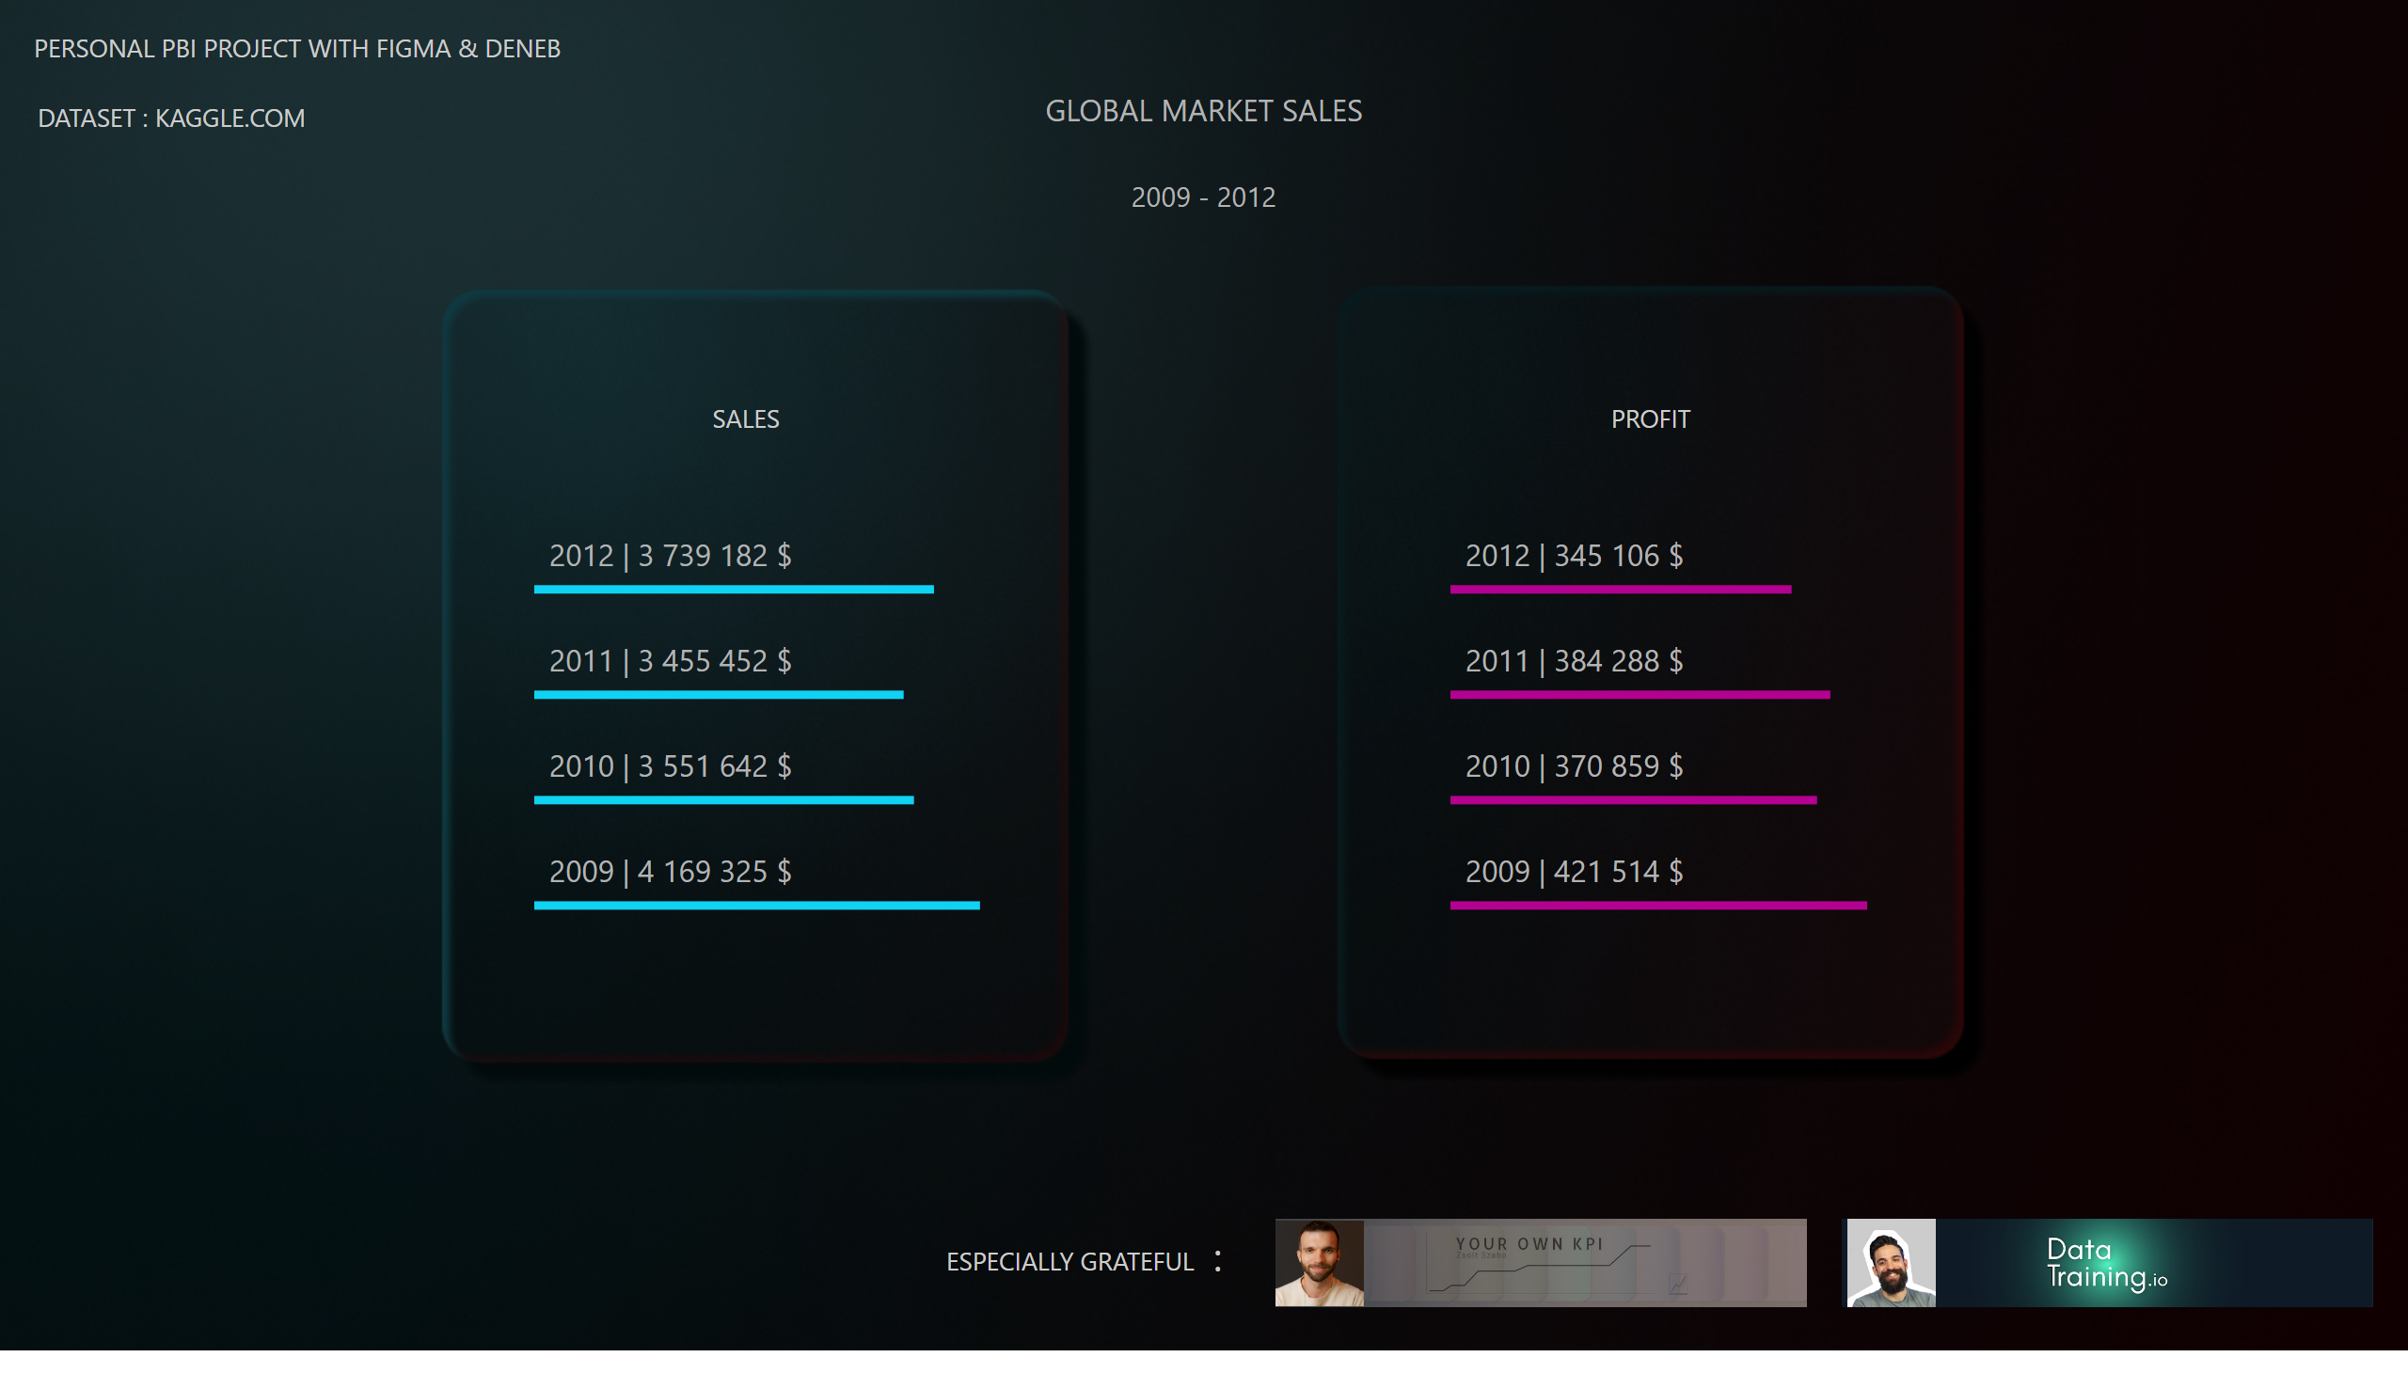
Home Page
Notes:
textbox
No alt text provided
textbox
No alt text provided
Sales
No alt text provided
Profit
No alt text provided
actionButton
No alt text provided
textbox
No alt text provided
textbox
No alt text provided
actionButton
No alt text provided
actionButton
No alt text provided
actionButton
No alt text provided
actionButton
No alt text provided
actionButton
No alt text provided
textbox
No alt text provided
textbox
No alt text provided
actionButton
No alt text provided
textbox
No alt text provided

Slide 3
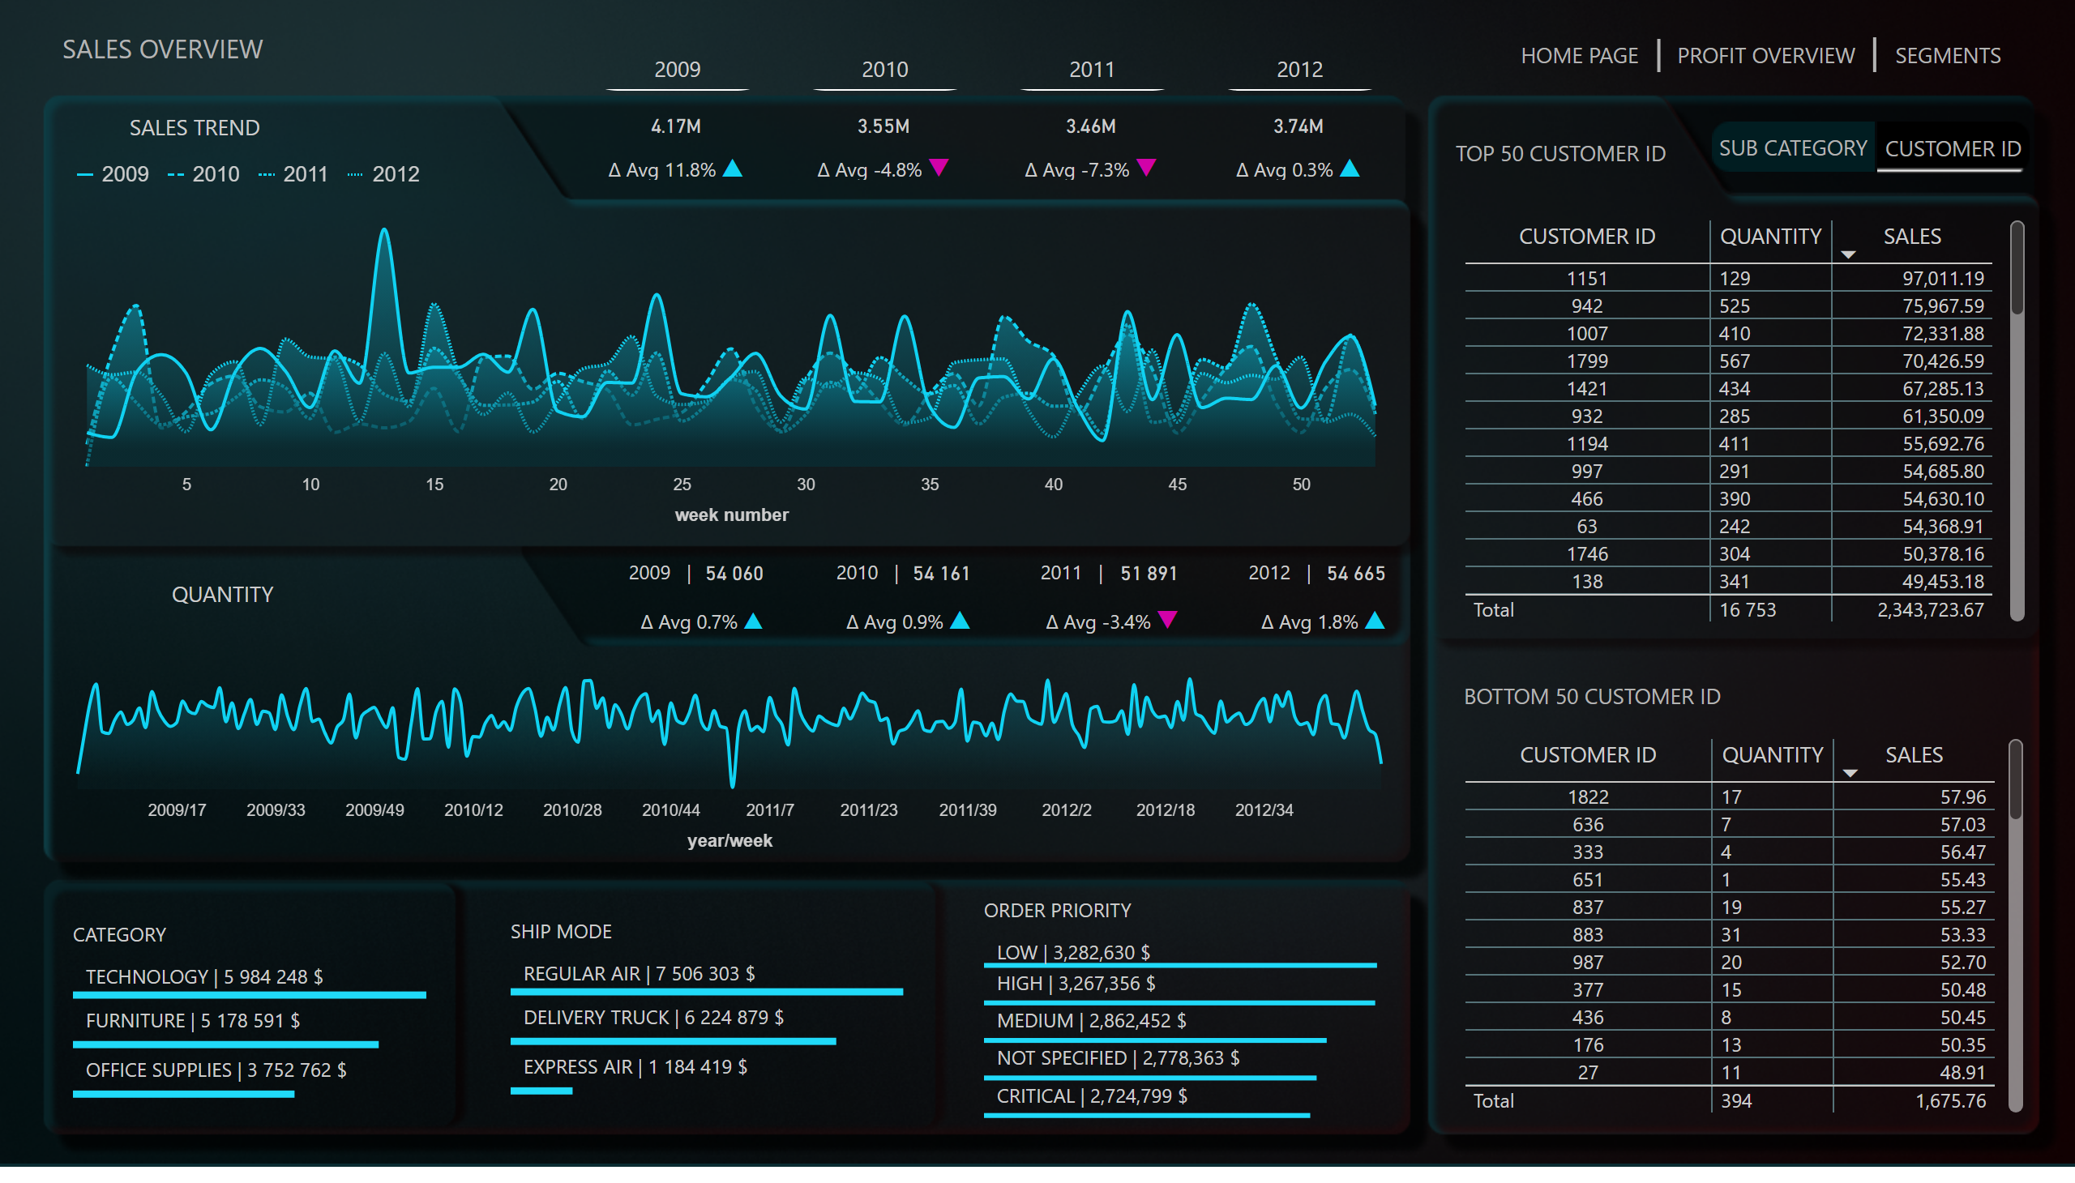
Sales Overview
Notes:
Year Slicer
No alt text provided
Top Cust
No alt text provided
Text Top Cust
No alt text provided
Top Cust
No alt text provided
Text Bot Cust
No alt text provided
Button SCAT1
No alt text provided
Button Cus1
No alt text provided
SHIP MODE
No alt text provided
CATEGORY
No alt text provided
textbox
No alt text provided
tableEx
No alt text provided
textbox
No alt text provided
tableEx
No alt text provided
actionButton
No alt text provided
actionButton
No alt text provided
Page heading
No alt text provided
ORDER PRIORITY
No alt text provided
Card Sales
No alt text provided
Card Qty
No alt text provided
Sales Heading
No alt text provided
Qty Heading
No alt text provided
textbox
No alt text provided
textbox
No alt text provided
textbox
No alt text provided
textbox
No alt text provided
Deneb Sales
No alt text provided
Deneb Qty
No alt text provided
Sales But
No alt text provided
Prof But
No alt text provided
shape
No alt text provided
Prof But
No alt text provided
shape
No alt text provided

Slide 4
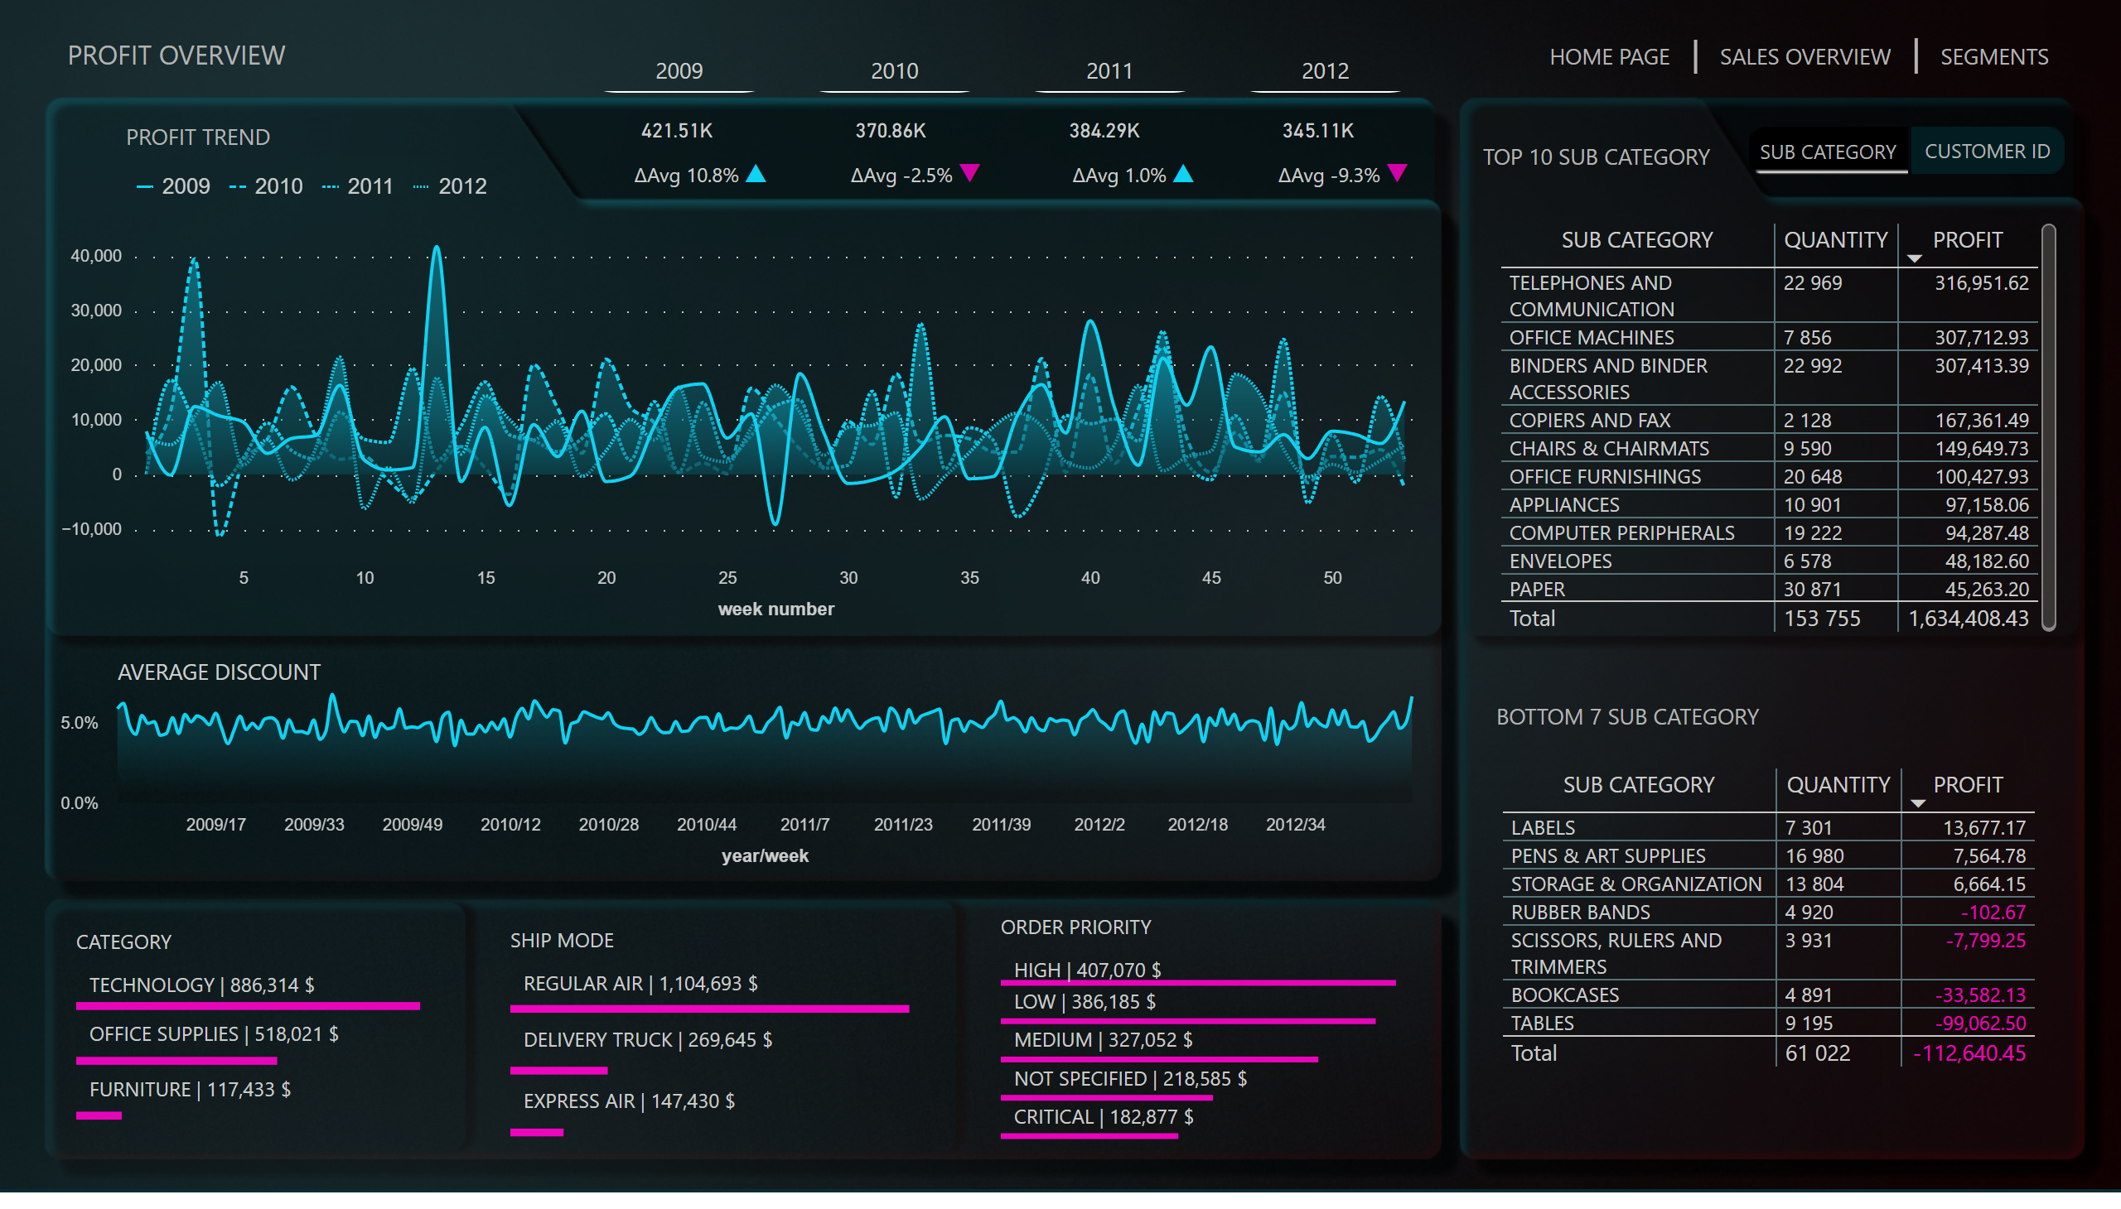
Profit Overview
Notes:
SHIP MODE
No alt text provided
CATEGORY
No alt text provided
Top Sub Category
No alt text provided
Text Bot 7 Sub Category
No alt text provided
Bot 7 Sub Category
No alt text provided
Text Top Sub Category
No alt text provided
Button Cust1
No alt text provided
Button Category1
No alt text provided
advancedSlicerVisual
No alt text provided
ORDER PRIORITY
No alt text provided
textbox
No alt text provided
textbox
No alt text provided
textbox
No alt text provided
cardVisual
No alt text provided
Button Category
No alt text provided
textbox
No alt text provided
tableEx
No alt text provided
textbox
No alt text provided
tableEx
No alt text provided
actionButton
No alt text provided
actionButton
No alt text provided
Button Cust
No alt text provided
deneb7E15AEF80B9E4D4F8E12924291ECE89A
No alt text provided
deneb7E15AEF80B9E4D4F8E12924291ECE89A
No alt text provided
Sales But
No alt text provided
Prof But
No alt text provided
shape
No alt text provided
Prof But
No alt text provided
shape
No alt text provided

Slide 5
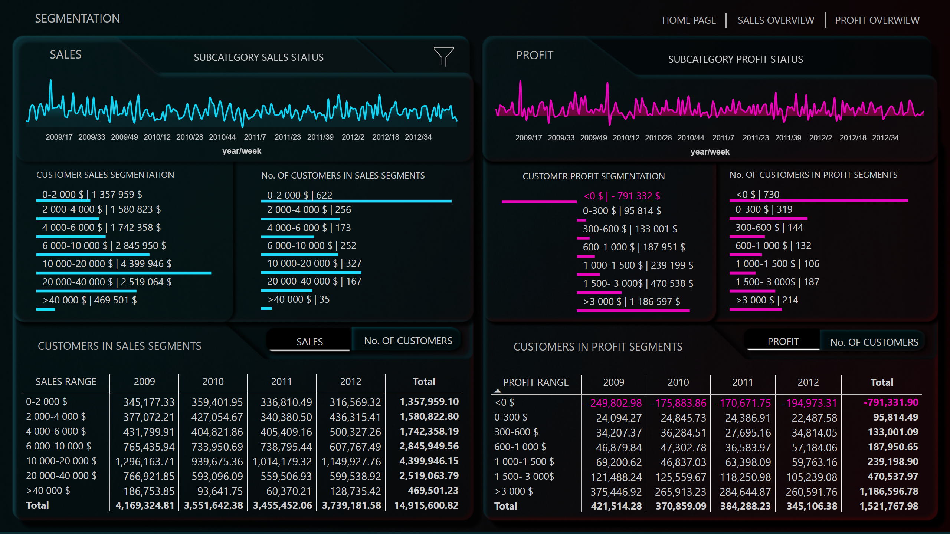
Sales/Profit Segments
Notes:
Deneb Sales
No alt text provided
CUSTOMER SALES SEGMENTATION
No alt text provided
No. OF CUSTOMERS IN SALES SEGMENTS
No alt text provided
pivotTable
No alt text provided
Sales CustSls Matrix
No alt text provided
Sales heading
No alt text provided
SubCat Sales Status Button
No alt text provided
Sales heading
No alt text provided
actionButton
No alt text provided
actionButton
No alt text provided
No. Cust Button InAct
No alt text provided
Sls Cust Button Act
No alt text provided
Filters Button
No alt text provided
Count Sls Slicers But
No alt text provided
Profit Segments Matrix
No alt text provided
No. OF CUSTOMERS IN PROFIT SEGMENTS
No alt text provided
Deneb Profit
No alt text provided
CUSTOMER PROFIT SEGMENTATION
No alt text provided
Profit heading
No alt text provided
Pr Status Button
No alt text provided
actionButton
No alt text provided
actionButton
No alt text provided
No. InAct Pr Button
No alt text provided
Prof Cust Act Button
No alt text provided
pivotTable
No alt text provided
Prof heading
No alt text provided
Page heading
No alt text provided
pivotTable
No alt text provided
actionButton
No alt text provided
image
No alt text provided
pivotTable
No alt text provided
actionButton
No alt text provided
image
No alt text provided
Sales But
No alt text provided
Prof But
No alt text provided
shape
No alt text provided
Prof But
No alt text provided
shape
No alt text provided
slicer
No alt text provided
textbox
No alt text provided
textbox
No alt text provided
slicer
No alt text provided
slicer
No alt text provided
slicer
No alt text provided
slicer
No alt text provided
slicer
No alt text provided
actionButton
No alt text provided
actionButton
No alt text provided
image
No alt text provided

